Slide 1
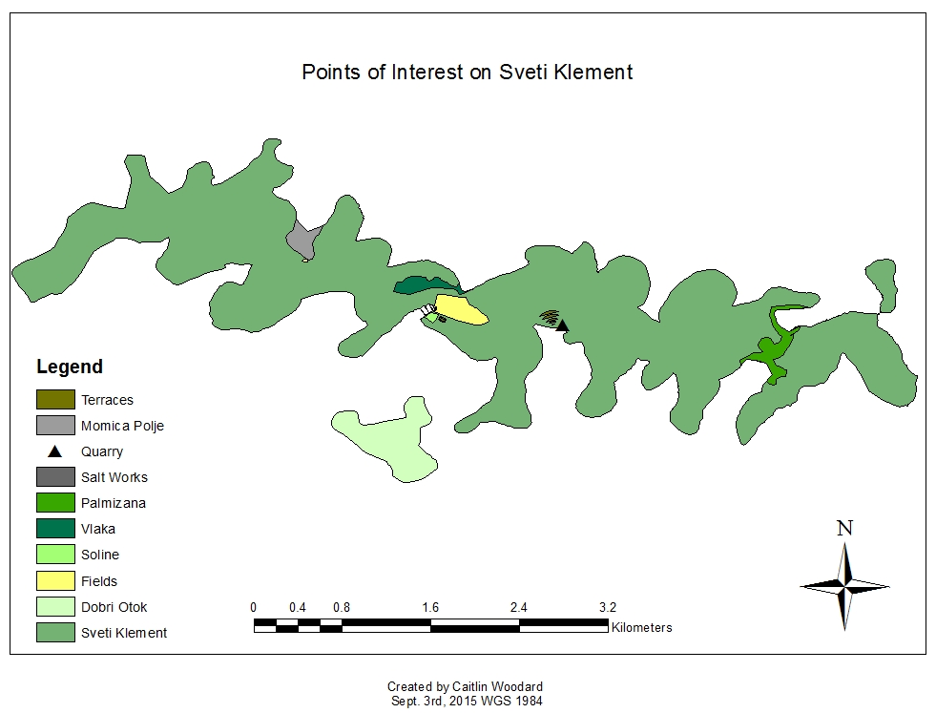
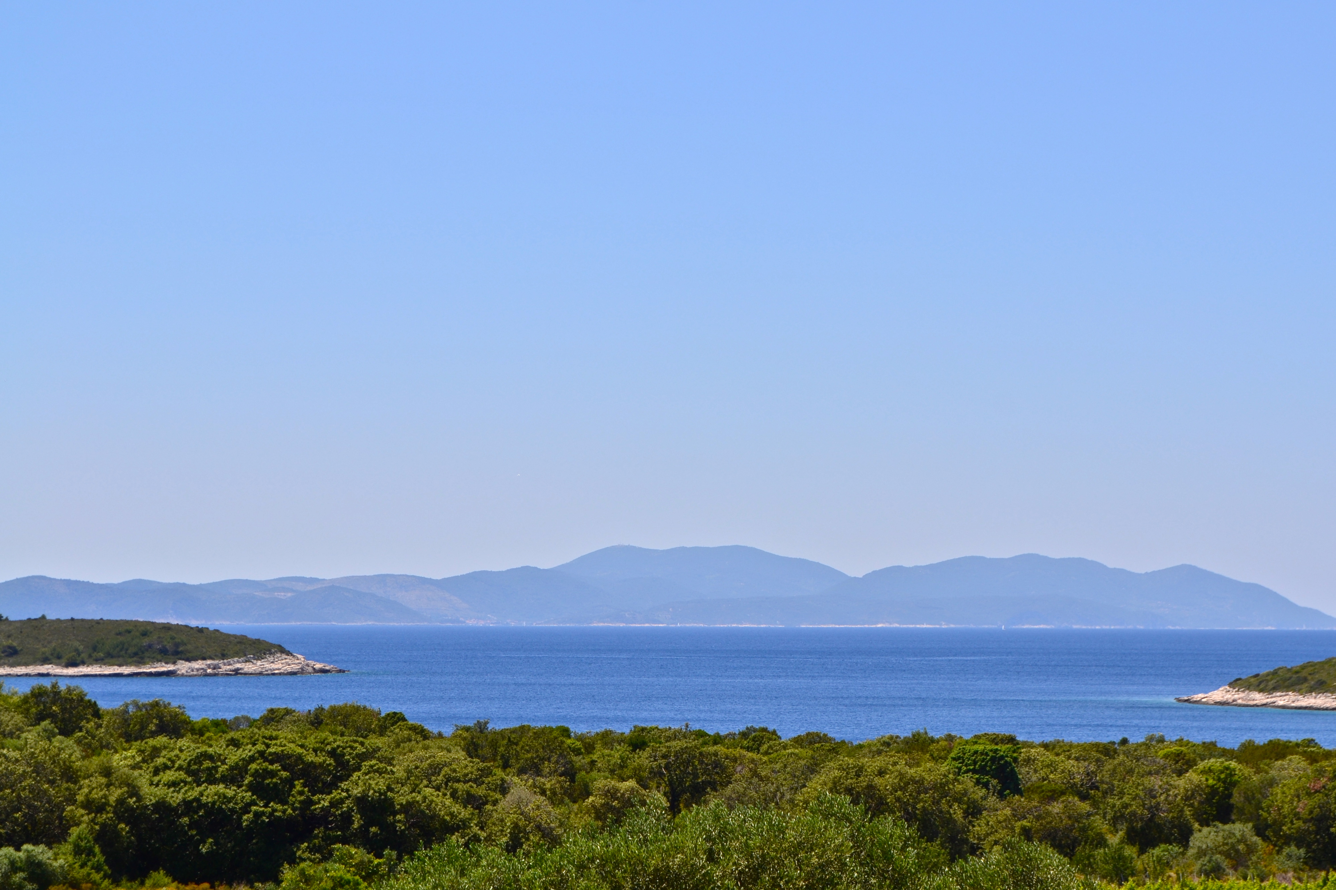
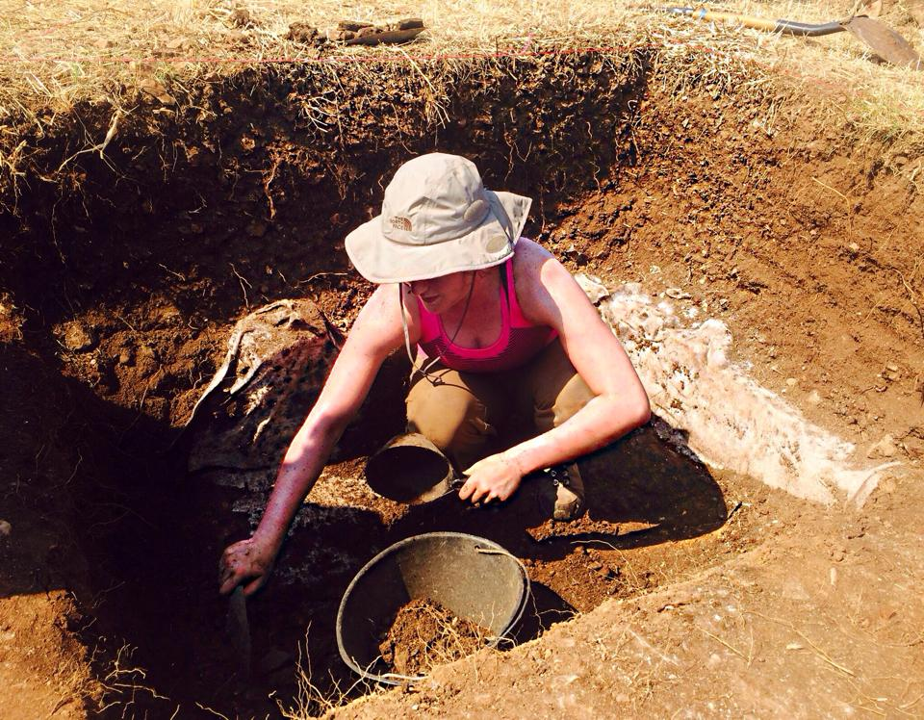

Comparing Human use of an Adriatic Island Environment During the Roman Empire and Modern Times on the Island of Sv. Klement
Caitlin Woodard and Dr. Ivancica Schrunk
Introduction
The island of Sv. Klement in central Dalmatia, Croatia, has been inhabited since prehistoric times. Since 2007, Dr. Ivancica Schrunk has been excavating a Roman villa in the Soline bay, located near the present village of Vlaka. Several UST geography students collected valuable geographic and ecological data about the island, but investigation about the relationship between humans and the environment have been only preliminary.
I have collaborated with Dr. Ivancica Schrunk on her archaeological research by assisting in the excavation of the ancient site to better understand the human activities and life during the Roman Empire. I have examined the present settlement in its landscape to determine how the locals utilize the environment.
This project is important to the broader community and to each of my fields of study. For environmental studies, it will highlight the impact of humans on an island environment. For geography, it will examine ancient and contemporary human interaction with landscapes unique to island environments. For history, it will illustrate historical change within an island habitat, and provide insight into the role of historical change throughout the entire Mediterranean region. This research will advance the multidisciplinary research of the Roman site and will allow me to apply different disciplines to realize world issues.
Conclusion
Although thousands of years have passed since ancient Romans occupied Sv. Klement, the island remains relatively unchanged. Artifacts and remains from the Roman Empire, visible throughout the island, reveal that ancient lifestyles were quite similar to modern lifestyles. The style of contemporary buildings is comparable to that of the Roman Empire. Ancient buildings were built from materials found on the island, like limestone from the quarry at Tarsce bay. Contemporary buildings are built from many different materials, because these materials are easily shipped from the mainland or other islands. While visiting Sv. Klement, I resided at a recently built guesthouse belonging to a man named Tonko. He explained that many modern buildings were built using stones from ancient structures that had collapsed or materials from neighboring islands like Dobri Otok. Stone is still the primary building material despite advancing architectural technologies.
The remains of agricultural terraces, composed of limestone from the quarry, are still visible. These previously viable terraces have succumbed to overgrowth brought on by generations of neglect. During the Roman Empire and, to a lesser extent, the present grapes and olives were commonly grown on agricultural terraces in the Mediterranean. Agricultural fields are more frequently used for crop production in modern times. Locals still avidly produce wine and olive oil, but the trading of such goods is no longer crucial to maintaining an island economy. Wine and olive oil are primarily produced to sell to tourists dining in local restaurants. While conducting research on Sv. Klement, I occasionally visited an establishment that made and bottled its own red wine. Besides grapes and olives, many different varieties of produce like tomatoes, cucumbers, wild mushrooms, and root vegetables are grown in the modern agricultural fields. The produce grown in the fields near Vlaka is used to cook meals for tourists in restaurants like Dionis and Pension Tonci. Although substantial evidence is lacking, many estimate that similar crops were grown in these fields during the Roman Empire.
The transition from a trade-based community during the Roman Empire to a society dependent on nautical tourism in present-day is by far the biggest difference between human utilization of land on an Adriatic island environment. The economy of Sv. Klement does not depend on trade like it did in ancient times. Modern economic success is powered by the booming nautical tourist industry. While life revloved around trade during the Roman Empire, each aspect of modern life on Sv. Klement is designed to benefit the nautical tourist industry. The Adriatic Sea, frequented by maritime traders in ancient times, plays a starring role in Mediterranean summer vacations for foreigners looking to soak up the sun.
Historical Background
The Soline settlement on Sv. Klement served as a productive community during the Roman Empire particularly between the fourth century AD and sixth century AD. Prior to Roman occupation and formation of the eastern Adriatic provinces, Greek settlements were founded in Dalmatia. The Greeks initially became interested in exploring the Adriatic region, because abundant economic opportunities existed. Greek colonies were fully established in Dalmatia by the early fourth century BC. These initial colonies were predominately located on Adriatic islands to promote trade with neighboring civilizations. The most significant colonies shaped by Greek settlers in the Adriatic region on the Dalmatian island: at Starigrad on Hvar, on the nearby island of Vis, and on the island of Korcula. Greek communities in Dalmatia remained productive and continued to be prosperous until the Romans gained interest in extending their rule across the Adriatic during the second century BC.
The Illyrian kingdom collapsed during the mid-second century BC allowing Roman political involvement to increase in this region. The Romans completely avoided instituting military commitment and administrative organization of this space until the mid-first century BC. During this time, Caesar transformed this profitable area into a unified zone of operations, and encouraged immigration to the eastern Adriatic coast. The urgency to incorporate Illyricum into the Roman world increased. Octavian’s successful expedition allowed for the establishment of an administrative, senatorial province at Illyricum towards the end of the first century BC. The geographical expanse of Illyricum proved difficult to manage. This resulted in the division of Illyricum into two administrative units, the future provinces of Dalmatia and Pannonia in 10 AD.
During the first century AD and second century AD, conditions proved favorable to accommodate the expansion of the Roman Empire. When Roman colonization efforts were directed toward conquering the eastern Adriatic region, maritime villas emerged in Dalmatia. This caused major demographic and settlement transformations throughout the rural areas of Dalmatian coastal plains and islands. Evidence suggests that these specific areas were fully Romanized by the fourth century AD. The maritime villa located at Soline matches the description of the villas built in Early Empire and Late Antiquity.
There are approximately 1,200 Adriatic islands and 69 of them are inhabited. Only a few year-round residents inhabit Sv. Klement the largest island in a group of islands called the Pakleni Otoci. Sv. Klement is approximately 5.28 km² with a coastline that is 29.89 km long. The coastal part of the island is quite barren and rocky while parts of the interior are covered with densely growing evergreen shrubs like oak, sage, juniper, and buckthorn. The highest point of the island is Vela Glava, which is 94 meters above sea level. There are many hidden beaches, crystal-clear seas, and deserted lagoons surrounding the island.
The map above was created using ArcGIS, and depicts points of interest on present-day Sv. Klement. The ancient settlement at Soline is located along the coast of the Soline bay. This map illustrates the short distance between the Soline bay and the island Dobri Otok, which helps visually explain the role of the island in protecting the bay from foreign and natural invaders. The Soline bay and settlement are situated on the narrowest stretch of land making it easy to move between the northern and southern coasts of the island. The Soline settlement is adjacent to the larger agricultural field. This close vicinity would have been an attractive characteristic to ancient Roman settlers.
This map also illustrates the ancient remains that are still visible on Sv. Klement. The salt works at the Soline bay were extensively utilized during the Roman Empire, but have been abandoned since medieval times. Documentation suggests the salt works have not been in use since the 16th century AD. Evidence indicates that the large field located near the Soline settlement was used in ancient times. A smaller agricultural field was located farther west near the abandoned village of Momica Polje. These agricultural fields are still functioning and yield a variety of crops. Today, the smaller field is less cultivated than the larger field. The new groves of olive trees that have been planted in the smaller field manage to produce a generous crop. Remains of agricultural terraces have been found in and around these fields. These remains have also been found near the quarry at the Tarsce bay on the southern side of the island.
Sv. Klement is home to three small villages including Momica Polje, Palmizana, and Vlaka. The recently abandoned village of Momica Polje is located on the western side of the island near the small agricultural field. Momica Polje was abandoned following World War II. Architectural remains of a small-scale agricultural society still stand. The remains of an ancient Roman villa, similar to the remains at the Soline settlement, exist a few miles south of Momica Polje. The eastern side of the island is the location of another small community known as Palmizana. A prominent marina exists on the northern side of Palmizana. The marina is a popular tourist destination for nautical tourists. The limestone quarry is still visibly located at the Tarsce bay between Palmizana and Vlaka. The small fishermen village, known as Vlaka, with about fifteen houses, a little chapel, vineyards, gardens, and olive groves exists in the center of the island. Although predominately a seasonal settlement, Vlaka has the most year-round residents out of all the villages on Sv. Klement. Vlaka is also the village closest to the settlement at Soline.
Works Cited
Begovic, Vlasta, Ivancica Schrunk, and Marina Ugarkovic. "Roman Villa in the Soline Cove on the Island of Sv. Klement near Hvar Preliminary Analysis of the Architecture According to Geophysical Investigations and Sondages.” Prilozi Instituta Za Arheologiju U Zagrebu. Vol. 21. Zagreb: Institut Za Arheologiju, 2012. 143-165. Print.
Bringmann, Klaus. "Chronological Table." A History of the Roman Republic. Cambridge, UK: Polity, 2007. 322-325. Print.
Bringmann, Klaus. "The Crisis of the Republic and Its Causes." A History of the Roman Republic. Cambridge, UK: Polity, 2007. 112. Print.
Bringmann, Klaus. "Rome and Italy." A History of the Roman Republic. Cambridge, UK: Polity, 2007. 1-56. Print.
Cawthorne, Nigel. "The Philippi War." Julius Caesar. London: Haus Pub., 2005. 109-110. Print.
Cvitanic, Marilyn. Preface. Culture and Customs of Croatia. Santa Barbara, CA: Greenwood, 2011. Print.
Davies, M. I. J., and Freda Nkirote M'Mbogori. "Forced Moves or Just Good Moves? Rethinking Environmental Decision Making among East African Intensive Cultivators." Introduction. Humans and the Environment: New Archaeological Perspectives for the Twenty-first Century. Oxford: Oxford UP, 2014. 57-76. Print.
Davies, M. I. J., and Freda Nkirote M'Mbogori. "Preface." Introduction. Humans and the Environment: New Archaeological Perspectives for the Twenty-first Century. Oxford: Oxford UP, 2014. Print.
Dzino, Danijel. "Rome and the Western Part of the Balkan Peninsula." Illyricum in Roman Politics: 229 BC-AD 68. Cambridge: Harvard University Press, 2010. 1-5. Print.
Gaffney, Vince and the Adriatic Islands Project Team. “A Game of Numbers: Rural Settlement in Dalmatia and the Central Dalmatian Islands.” Dalmatia: Research in the Roman Province 1970-2001. By David Davidson. Oxford: Archaeopress, 2006. 89-106. Print.
Gaffney, Vince, and Emilio Marin. "The Greek Background." Dalmatia: Research in the Roman Province 1970-2001. By David Davidson. Oxford: Archaeopress, 2006. 17-26. Print.
Gaffney, Vince, and Emilio Marin. "Rural Settlements." Dalmatia: Research in the Roman Province 1970-2001. By David Davidson. Oxford: Archaeopress, 2006. 175-189. Print.
Griffin, Miriam T. “Caesar as a Politician.” A Companion to Julius Caesar. Chichester, U.K.: Wiley-Blackwell, 2009. 23-36. Print.
Griffin, Miriam T. “The Dictator.” A Companion to Julius Caesar. Chichester, U.K.: Wiley-Blackwell, 2009. 57-71. Print.
Hall, Derek R., Melanie K. Smith, and Barbara Marciszewska. "Croatia in the New Europe: Culture versus Conformity." Tourism in the New Europe: The Challenges and Opportunities of EU Enlargement. Wallingford, UK: CABI, 2006. 288-304. Print.
Magaš, Branka. Introduction. Croatia through History: The Making of a European State. London: Saqi, 2007. 11-16. Print.
Mommsen, Theodor. "The Danubian Lands and the Wars on the Danube." The Provinces of the Roman Empire: From Caesar to Diocletian. Chicago: U of Chicago, 1968. 195-251. Print.
Scheidel, Walter. The Cambridge Companion to the Roman Economy. Cambridge: Cambridge University Press, 2012. Print.
Schrunk, Ivancica. "Roman Villas in Istria and Dalmatia, Part III: Maritime Villas." Prilozi Instituta Za Arheologiju U Zagrebu. By Vlasta Begovic. Vol. 21. Zagreb: Institut Za Arheologiju, 2004. 65-90. Print.
Stipčević, Aleksandar. Gli Illiri. Zagreb: Skolska Kniga, 1966. Print.
Wilkes, J. J. "The Roman Province and Its Governors." History of the Provinces of the Roman Empire: Dalmatia. Cambridge, MA: Harvard UP, 1969. 78-87. Print.
Research Question
How did inhabitants utilize the Adriatic island environment on Sv. Klement during the Roman Rmpire in comparison to modern times? If there are differences, what environmental, geographical, and historical factors contributed to such developments? How and why?

